Slide 1
Compliance 101: An Overview of Health Care Compliance and Integrity Programs
Nina W. Tarnuzzer, MHA,CPA,CPC
Assistant Dean, Physician Billing Compliance
University of Florida, College of Medicine
Monday, November 7, 2011

Slide 2
Helpful Disclosure
Warning: These printed materials are not designed to include all points that will be presented in class or include information helpful to know for purposes of testing.

Slide 3
Presentation Summary
Fundamental programmatic elements
Commitment, culture and organization
Core elements of a program
Key Challenges
A rapidly changing environment
Regulatory hot buttons
What are the rules, anyway?
Compliance as a Profession

Slide 4
Why is Compliance a Hot Topic?
Largest $$$ Federal Programs
Largest $$$ State Programs
Large organizations, large scale fraud and abuse
Recoveries ($$Enforcement/$$ Recovery) Ratio is Excellent
Recoveries in BILLIONS of dollars

Slide 5
In just three years, the Medicare and Medicaid programs will account for 50 percent of all national health spending.
Medicare's Hospital Insurance (HI) Trust Fund is expected to pay out more in hospital benefits and other expenditures this year than it receives in taxes and other dedicated revenues. In addition, the Medicare Supplementary Medical Insurance (SMI) Trust Fund that pays for physician services and the prescription drug benefit will continue to require general revenue financing and charges on beneficiaries that will grow substantially faster than the economy and beneficiary incomes over time.
National Coalition on Health Care

Slide 6
National Health Care Spending
National health spending is expected to reach $2.5 trillion in 2009, accounting for 17.6 percent of the gross domestic product (GDP). By 2018, national health care expenditures are expected to reach $4.4 trillion—more than double 2007 spending.1
National health expenditures are expected to increase faster than the growth in GDP: between 2008 and 2018, the average increase in national health expenditures is expected to be 6.2 percent per year, while the GDP is expected to increase only 4.1 percent per year.

Slide 7
Simple Version of Compliance
Identify RISK
Explain the RISK to your organization
Identify PROBLEMS
FIX PROBLEMS
REPEAT

Slide 8
Compliance is usually perceived as dry and boring
Until… …something goes wrong
Refunding, legal bills, damage to reputation, potential criminal charges are not boring, but not where you want to be

Slide 9
Simple Version – Federal view
The federal government is no longer going to “pay and chase” errors. Providers are responsible for accurate and honest requests for payment, and are expected to get it right. Do not expect to submit a bill to the federal government and the government have the burden of determining if it appropriate to pay. There will be serious consequences for both careless and intentional claims for services to which the recipient is not entitled.

Slide 10
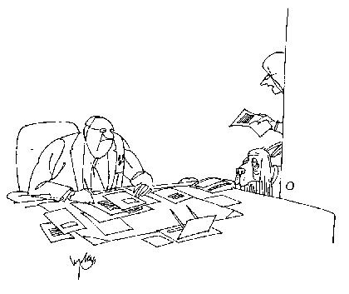
“An early Christmas gift from our compliance officer… a bloodhound trained to sniff out non-compliant providers.”

Slide 11
Data on insurance premium costs
The average employer-sponsored premium for a family of four costs close to $13,400 a year, and the employee foots about 27 percent of this cost.4 Health insurance costs are the fastest growing expense for employers. Employer health insurance costs overtook profits in 2008, and the gap grows steadily
Employees have seen their share of job-based coverage increase at nearly the same rate during this period jumping from $1,543 to $3,515.

Slide 12
Fundamentally, an ethics and compliance program has two purposes: to ensure that all individuals in an organization observe pertinent laws and regulations in their work; and to articulate a broader set of aspirational ethical standards that are well-understood within the organization and become a practical guideline for organization members making decisions that raise ethical concerns.
Alan Yuspeh, JD, Sr VP Ethics, Compliance and Corporate Responsibility

Slide 13
)
Must have the active support of senior management
Is fundamentally about corporate culture- instilling the commitment to observe the law, and more generally, do the right thing
Operating management are committed to the success of the compliance program (the compliance office can’t do it for them.)
The ethics and compliance effort should be about the conduct of individu
Alan Yuspeh, JD, Sr VP Ethics, Compliance and Corporate Responsibility

Slide 14
Key Challenges
We function in a highly complex, rapidly changing environment
Number of rules and laws more complex and technical, number of rules increasing
Substantial fines and enforcement actions, negative publicity
Legal requirements vs. Ethical responsibility
Following the law isn’t good enough

Slide 15
Perspective One - A Contract
Compliance with Federal and State legal requirements
If you accept federal or state money, you must conduct your business according to their standards
Protecting Private information
Key target for identity theft
Confusion and error in the victim’s medical record as diagnoses for other people’s conditions are added.

Slide 16
Beyond what’s in the contract…
What are the “Rules”?
Laws and regulations
Industry standards
“Best” and “Sound” practices
Ethical norms
Where do you set the bar?

Slide 17
Challenges: Business Perception of Compliance
Requirements not designed by physicians, many times not consistent with delivery of quality care
Cost of compliance program –
Time requirements
Some rules just not very clear

Slide 18
Compliance Officer’s Job Description
JD, MBA, MHA and/or CPA
Progressive levels of experience in the field
Communication skills – speaking and writing
Diplomatic/People skills
Strong sense of core values
Thick skin
Must report “high” in the organizational structure

Slide 19
Diplomatic skills are important

Slide 20
Current Areas
Physician Billing
Hospital Billing
Privacy
Clinical Trials and Research
Conflict of Interest
Employment (Sarbanes-Oxley)
DME
Enforcement Agencies
Consultants

Slide 21
Difference between Criminal and Tort Law
Fraud – is knowingly and willfully executing or attempting to execute, a scheme or artifice to defraud any health care benefit program or to obtain, by means of false or fraudulent pretenses, representations, or promises, any of the money or property owned by, or under the custody or control of any health care benefit program.
Mens rea - the “mental element”

Slide 22
Difference between Criminal and Tort Law
Abuse may directly or indirectly, result in unnecessary costs to the Medicare or Medicaid program, improper payment, or payment for services which fail to meet professionally recognized standards of care, or that are medically unnecessary. Abuse involved payment for items or services when there is no legal entitlement to that payment and the provider has not knowingly and/or intentionally misrepresented facts to obtain payment.

Slide 23
FEDERAL ENFORCEMENT AND THE FALSE CLAIMS ACT- and Qui Tam lawsuits (whistleblowers)
The US Sentencing Commission-
Created by Congress in 1984, its purpose is to draft narrow parameters for determining criminal sentencing. The original intent was to standardize criminal penalties. There are now specific guidelines for violations of Healthcare law, that help define the Federal Government’s expectations.

Slide 24
The Program Mission
A compliance program built to accomplish its mission:
To Deter
To Detect
To Address the issues promptly

Slide 25
7 Common Elements in Compliance Guidelines
Implement written policies, procedures, and standards of conduct
Designating a compliance officer and a compliance committee
Conducting effective training and education
IMPORTANT

Slide 26
7 Common Elements in Compliance Guidelines
Developing effective lines of communication
Enforcing standards through well publicized disciplinary guidelines
Conducting internal audits and monitoring
IMPORTANT

Slide 27
7 Common Elements in Compliance Guidelines
Responding promptly to detected offenses and developing corrective action.
IMPORTANT

Slide 28
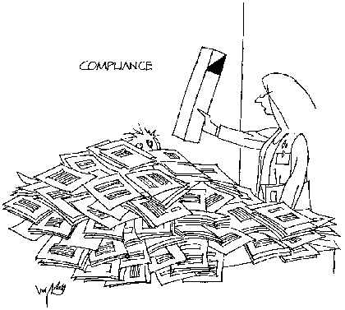
“You can’t reduce the paper work, so here is a periscope to see over it.”

Slide 29
Federal Guidelines
Tip: “guidelines” is a misnomer. The federal government makes these guidelines mandatory – even in voluntary programs. (DRA 2005)

Slide 30
A Federal Priority
Center for Medicare and Medicaid Services (CMS)
Office of the Attorney General
FBI
Office of Inspector General
The Legislature has passed strong enabling legislation including the Balanced Budget Act and HIPAA

Slide 31
A Federal Apparatus is now in place
Billions are recovered – Qui Tam relators 85% of case load
From the substantial settlements – the programs move toward becoming self-funding
State Medicaid programs have their own False Claims rules
Over 38,000 persons have been excluded from participation

Slide 32
Government Programs with Active Enforcement
STATE MEDICAID Programs
MEDICARE –
Part A – Hospitals and Nursing Homes
Part B - Physician Services
Part D - Prescription Drugs
Durable Medical Equipment

Slide 34
It’s important for everyone to know the rules
THE STANDARD
The severity of the punishment or settlement comes down to what the organization KNOWN or SHOULD HAVE KNOWN when it submitted false or fraudulent claims.

Slide 35
Penalties for non-compliance
Reimbursement (pay what you owe back), Civil penalties and interest
They can suspend your billing until you go out of business
Exclusion of you as an individual from any company doing business with the Federal government
Exclusion of institution from participation in Medicare and Medicaid
Criminal charges – you can go to jail

Slide 36
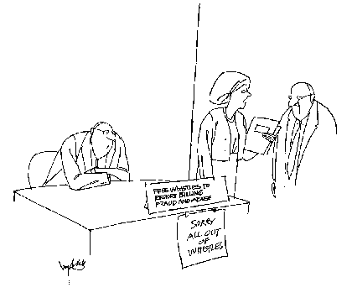
“May I suggest a compliance program?”

Slide 37
Trends – Sophisticated Analysis and Monitoring
Data mining – matching data from different types of service (i.e., physician compared to hospital)
Recovery Audit Contractors
Private companies that are paid based on a percentage of recovery (bounty hunters)

Slide 38
Pfizer Settlement - 2009
Already under a CIA
Largest health fraud settlement in US history
Most extensive CIA ever imposed
Whistleblower was John Kopchinski – a former sales rep
$2.3 billion settlement
Criminal fine of $1.195 billion
Promotion of Bextra for several uses and dosages that FDA specifically declined to approve due to safety concerns.
Bextra, Geodon, Zyvox, and Lyrica

Slide 40
May 20, 2009
FERA - Fraud Enforcement and Recovery Act of 2009
Introduced by Senators Patrick Leahy (D-VT), Ted Kaufman (D-DE) and Chuck Grassley (R-IA)
HEAT – Health Care Fraud Prevention and Enforcement Action Team
Attorney General , Eric H. Holder, Jr. and Health and Human Services (HHS) Secretary, Kathleen Sebelius, announced the new and aggressive inter-agency task force.

Slide 41
FERA
Made it a violation of the False Claims Act to knowingly and improperly retain government money if there is an obligation to return the money.
The health reform bill states that “an overpayment must be reported and returned” within 60 days of the date the provider “knows of the overpayment”.
Draft of America’s Affordable Health Choice Act defines a Medicare or Medicaid overpayment” as “any finally determined funds that a person receives or retains … …to which the person , after applicable reconciliation, is not entitled.”
Providers not off hook for civil or criminal sanctions if fraud involved

Slide 42
Watch America’s Affordable Health Choices Act of 2009
1,000 page bill (H.R. 3200) devotes 55 pages to program integrity and fraud-fighting measures
Integrity plans will be a requirement for participation
Already required under the Deficit Reduction Act of 2005 for many providers (>$5 million)
Spells out the required elements including a hotline, auditing and monitoring, procedures to return overpayments
Failure invites civil penalties or disenrollment

Slide 43
Case states that Compliance role must be both proactive and reactive
Proactive efforts need to emphasize the complimentary goals of prevention and corporate ethical behavior.
Reactive efforts measure how well a corporation reacts when it learns that questionable and potentially illegal corporate conduct has occurred
- United States v. Caputo

Slide 45
Questions?

